Slide 1
PROTEST NEWS tEAM: MINERS
CSE 635: NLP & TEXT MINING

Slide 2
Content
Problem Statement
Dataset
Slot Filling
Summarization
Results

Slide 3
Problem Statement
Goal: To extract event data from textual data and give details of the events and summarize them.
Event classes of interest: Global social unrest events, such as demonstrations, marches, and protests from 2019.
Countries of interest: India and South Africa
Primary tasks involved in this project:
Task 1: Event Extraction and Slot filling
Task 2: Text Summarization

Slide 4
Dataset
The dataset used for this project evaluation is the ACLED dataset.
We use this dataset to collect data on various marches, demonstrations and protests that were held in 2019 in India and South Africa.
Reverse search techniques are used in order to retrieve various news articles from the ACLED dataset which contains all the relevant data on the political unrest in both the countries.
After data cleaning, we have a total of 2100 training samples and 821 testing samples.

Slide 5
Slot Filling
Slots considered in this project are:
Location
Event Date
Event Type
Parties Involved
Summary

Slide 6
Location
Baseline approach:
We used spacy and Stanford NERTagger to tag the locations and choose the first hit as the final output.
Final approach:
Preprocessing data (to mostly account for the verbs and the actual location):
Stop words removal.
Tokenization
We used Stanford NLTK library to find the locations as spacy location tags gave ambiguous results in the proper nouns(NNP tags) and actual locations(GPE/LOC tags).
We used spacy POS tagging to find the verbs in a sentence using the verb tags provided by the library.
After getting the verbs we calculate the total number of verbs around a location in the text and select the location with maximum verb count as the final location.
Evaluation is done considering all the location slots in the ACLED dataset.

Slide 7
Date
We used spaCy, Stanford NLTK to extract the event date.
In addition, we used datefinder library for date extraction which gave better results when compared with spacY, and nltk.

Slide 8
Event Type
Baseline Approach: SpaCy
Storing the word embedding of the word “protest”.
For each unique word in the article, we’re taking its word embedding and finding the cosine similarity with “protest”.
Final Approach: BERT Classifier
Transformer-based language model architecture.
We train BERT classifier to detect the type of protest.

Slide 9
Actors
Baseline Approach: Used Stanford NERTagger to extract all the persons and organizations. Then ranked the results based on:
Word Frequency or closeness in position with the event_type
Final Approach: Used Shallow parsing along with named entity tagging
First, we extracted all the noun phrases from the first few sentences
Among the extracted results, we took all the persons and organizations and ranked them similar to baseline.

Slide 10
Results (Slot-Filling)
 | Precision | Recall | Accuracy | F1-Score
Event Date | Baseline: 0.545 Final: 0.545 | Baseline: 0.857 Final: 0.857 | Baseline: 0.635 Final: 0.635 | Baseline: 0.667 Final: 0.667
Location | Baseline: 0.741 Final: 0.868 | Baseline: 0.983 Final: 0.875 | Baseline: 0.744 Final: 0.811 | Baseline: 0.845 Final: 0.871
Event Type | Baseline: 0.5 Final: 0.98 | Baseline: 0.713 Final: 0.98 | Baseline: 0.487 Final: 0.983 | Baseline: 0.588 Final: 0.98
Actors Involved | Baseline: 0.286 Final: 0.623 | Baseline: 0.260 Final: 0.633 | Baseline: 0.180 Final: 0.524 | Baseline: 0.272 Final: 0.628

Slide 11
Comparison against State-of-art results (Slot-Filling)
Model Name | Average F1-Score (%)
Bi-Model with decoder (Wang, Yu et al., 2018) | 96.89
Stack-Propagation + BERT (Qin, Libo et al., 2019) | 96.10
Our Models | 78.65

Slide 12
Summarization
Baseline Approach
Encoder-Decoder model with attention mechanism.
For training, used pre-trained weights trained on CNN / Daily Mail
BERT based extractive model
Used BERT extractive summarizer python library which uses BERT for generating extractive summary
Source: https://arxiv.org/ftp/arxiv/papers/1906/1906.04165.pdf

Slide 13
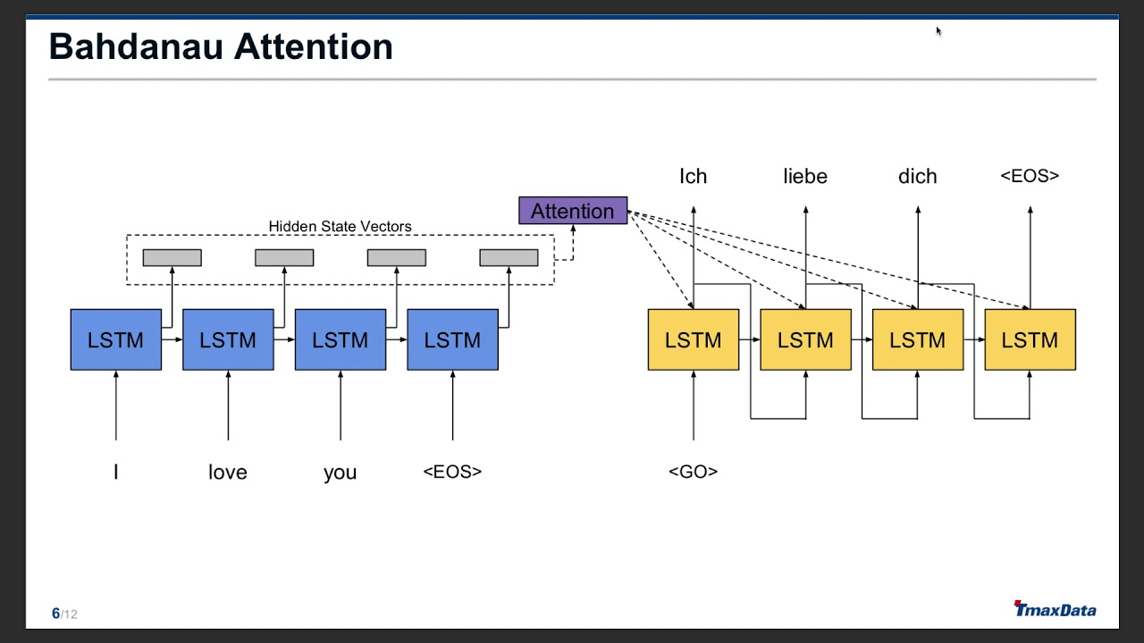
Summarization (Final Model)
Final Approach
Multi-layer LSTM encoder decoder model with attention mechanism
Data Preprocessing:
Removing stopwords, html tags, punctuations, special characters, short characters.
Tokenizing, Lemmatization / Stemming using nltk.
Use glove pre-trained vectors for initializing word embedding.
Text Summarization:
Used Multi-layer LSTM encoder decoder model with attention
mechanism to train model (Bahdanau attention).
Input: The word embeddings of an article(max_length = 400)
Output: The summary of the article (max_length = 50)

Slide 14
Sample Summary
Actual: On 17 June, doctors staged a protest, led by IMA, in Dibrugarh (Assam) to condemn the recent attack on junior doctors in Kolkata and to demand security for medical professionals across the country. [size=no report]
Baseline: KOLKATA/NEW DELHI (Reuters) - A leading Indian doctors’ association called for a nationwide strike on Monday, stepping up protests by medical staff demanding better security at hospitals after an attack on doctors in Kolkata.
Final Model: on 17 june doctors staged a protest in agartala city as part of a nationwide strike after a clash between family members and doctors on june 10 in kolkata city left a junior doctor seriously injured size no report

Slide 15
Results (Summary)
 | BERT based Extractive Summarization (Baseline) | Multi-layer LSTM Encoder-Decoder model with local attention (Final)
 | F1-score | F1-score
ROGUE-1 | 0.40856711 | 0.42560520
ROGUE-2 | 0.15817283 | 0.22038020
ROGUE-l | 0.32331820 | 0.39879427

Slide 16
Comparison against State-of-art results (Summarization)
Model name | ROGUE-1 | ROGUE-2 | ROGUE-L
 | F1-Score (%) | F1-Score (%) | F1-Score (%)
ProphetNet (Yan, Qi, Gong, Liu et al., 2020) | 44.20 | 21.17 | 41.30
PEGASUS (Zhang et al., 2019) | 44.17 | 21.47 | 41.11
BART (Lewis et al., 2019) | 44.16 | 21.28 | 40.90
Our Final Model | 42.56 | 22.04 | 39.88

Slide 17
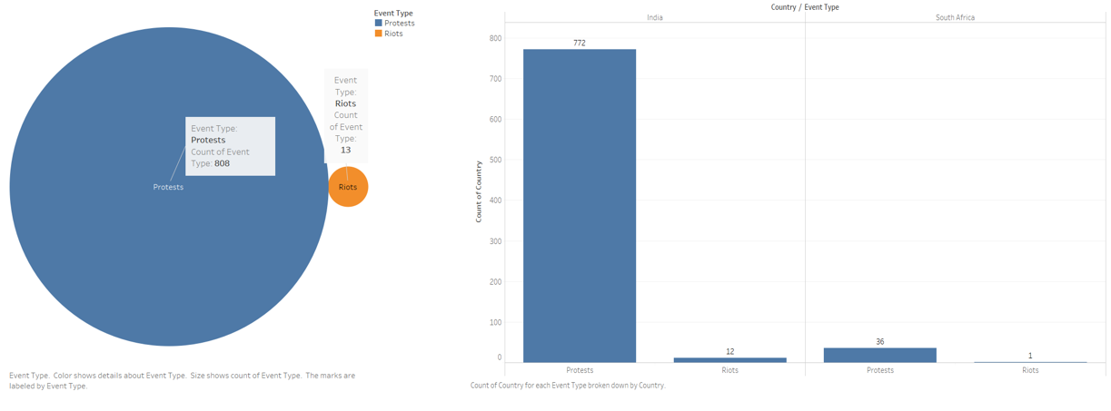

Slide 18
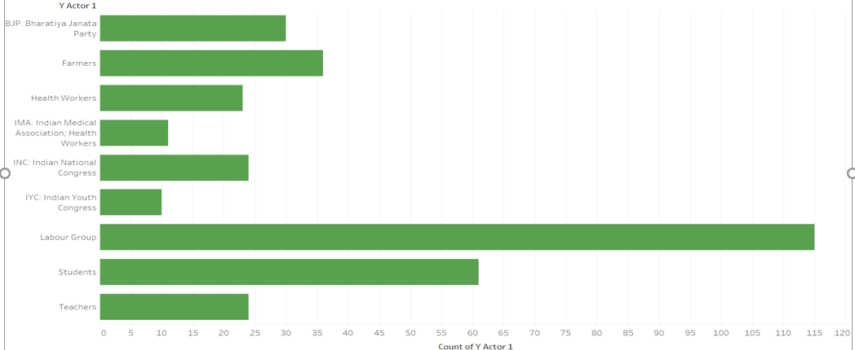

Slide 19
Further work
Slot-Filling:
For slot-filling, we’re thinking of using transformer-based models and make a general model for all slots instead of separate ones for each task.
Summarization:
Increase the training data size
Try different approaches (Bi-directional LSTM, beam search, transformer models, …)

Slide 20
THANK YOU

